Slide 1

Zero Trust Security
Framework for
Healthcare Systems
Guided by,
Dr. Swapna M.P
Sherin Shibu
AM.EN.U4CSE22355
Toufeeq SK
AM.EN.U4CSE22356
Varun Dipu Sankar
AM.EN.U4CSE22359
Harini Sivakumar
AM.EN.U4CSE22363

Slide 2
Outline
1
Introduction
2
Problem & Objective
3
Proposed Solution Overview
4
System Architecture / Design
5
Implementation Details
6
Results & Performance
7
Evaluation & Analysis
8
Challenges & Solutions
9
Conclusion
10
Future Scope
11
Publication Status
2
Zero Trust Security Framework for Healthcare Systems
AMRITA VISHWA VIDYAPEETHAM

Slide 3
Introduction
34%
Zero Trust
EDR + Microsegmentation
of healthcare organization hit by ransomware (2023)
"Never trust, always verify" — new paradigm
Endpoint monitoring + dynamic network isolation
Healthcare has rapidly adopted EHRs, Internet Of Things medical devices, and cloud systems dramatically expanding the attack surface and creating new entry points for adversaries.
Traditional perimeter-based security trusts all internal users by default a fundamentally flawed assumption exploited by ransomware, phishing, and insider threats.
The Zero Trust Architecture (ZTA) principle — "never trust, always verify" enforces continuous identity and device verification before any access is granted, regardless of location.
Endpoint Detection and Response (EDR) solutions provide real-time visibility into processes, file changes, network traffic, and logs on every critical endpoint.
Network microsegmentation divides the infrastructure into isolated segments, preventing lateral movement and containing breaches to a single zone if an endpoint is compromised.
SecureHealthCare combines both: Phase I delivers identity-based access control (IAM, SDP, MFA, JWT), Phase II delivers continuous telemetry, hybrid detection, and automated response.
The framework is containerized in Docker Compose with 12 microservices, proving architectural feasibility for real-world healthcare deployment.
3
Zero Trust Security Framework for Healthcare Systems
AMRITA VISHWA VIDYAPEETHAM

Slide 4
Problem & Objective
Problem Statement
Objectives
Traditional perimeter security trusts all internal users by default inadequate for modern healthcare environments.
EHRs, IoT medical devices, and administrative systems coexist in shared networks with insufficient segmentation.
Security breaches compromise sensitive patient data, disrupting hospital operations and endangering lives.
Existing solutions are fragmented — no integrated, adaptive, and auditable defense mechanism exists.
Aligns with SDG 16: Peace, Justice and Strong Institutions — enabling accountability and trust in healthcare.
Deploy EDR solutions for real-time threat detection across critical healthcare endpoints.
Apply microsegmentation to control access, reduce lateral movement, and strengthen network security.
Install endpoint monitoring agents on critical systems for continuous process, file, and network visibility.
Centralize security monitoring using hybrid detection: rule-based signatures + ML-based anomaly analysis.
Demonstrate automated responses — token revocation, access restriction, network isolation — during simulated attacks.
4
Zero Trust Security Framework for Healthcare Systems
AMRITA VISHWA VIDYAPEETHAM

Slide 5
Proposed Solution Overview (1 of 2)
SecureHealthCare — a Zero Trust framework for healthcare delivering identity-based access control, continuous endpoint monitoring, and automated threat containment.
Phase I — Identity & Access Control
Phase II — Monitoring & Detection
Response Automation
IAM Server: registration, bcrypt login, TOTP MFA, JWT token issuance
API Gateway: public entry point, bearer token validation + forwarding
SDP Controller: role/permission policy evaluation for each request
SPA Controller: short-lived admission grants for protected services
AES-256-GCM encryption of all sensitive patient data at rest
EDR Agents on all critical endpoints: process, file, network, log events
Centralized Telemetry Collector: structured JSON event stream
Rule-Based Engine: healthcare-specific threat signatures (EXFILTRATION, RANSOMWARE, BRUTE FORCE)
ML Engine: Random Forest trained on CSE-CIC-IDS2018 (95.27% recall)
Parallel detection — rules catch known threats, ML catches unknown anomalies
Response Controller: severity-aware enforcement (CRITICAL / HIGH / LOW)
Actions: isolate segment, revoke IAM tokens, revoke SDP access, log-only
Microsegmentation via SDP segment state change — dynamically enforced
Reversible: revert_isolation action available after threat confirmation
Full audit trail: host identity, trigger, severity, timestamp, rollback
5
Zero Trust Security Framework for Healthcare Systems
AMRITA VISHWA VIDYAPEETHAM

Slide 6
Proposed Solution Overview (2 of 2)
High-Level Request & Response Workflow
1
2
3
4
5
User
Request
Identity
Verify
Policy
Gate
Telemetry
Stream
Detect &
Respond
Client hits
hospital portal
frontend
IAM: bcrypt +
TOTP MFA →
JWT issued
API Gateway → SDP
→ SPA: role +
admission check
EDR agents →
collector →
structured JSON
Rules + Random Forest ML
→ alert → auto
isolate/revoke
Key Novelties
Two-phase architecture: Phase I handles authentication/authorization, while Phase II handles monitoring, detection, and response.
Unified endpoint monitoring and dynamic network isolation within a Zero Trust healthcare framework.
Hybrid detection engine: deterministic rule engine + Random Forest ML anomaly detector running in parallel for complementary coverage.
Automated, auditable, and reversible enforcement: every action logged with host identity, trigger, severity, and timestamp.
6
Zero Trust Security Framework for Healthcare Systems
AMRITA VISHWA VIDYAPEETHAM

Slide 7
System Architecture / Design (1 of 3) — Phase I: Identity & Access
Frontend Application
IAM Server
API Gateway
SDP Controller
Hospital portal serving the user interface; initiates MFA login and provides role-based views for all 8 user roles.
Handles registration, bcrypt password verification, TOTP MFA, JWT access + refresh token issuance on successful auth.
Public entry point — validates bearer tokens, rejects unauthenticated requests, forwards valid requests to SDP.
Evaluates role/permission policy for every request: checks user role against allowed resource paths and HTTP methods.
SPA Controller
Backend + Internal GW
Encryption Service
PostgreSQL Database
Single Packet Auth — issues short-lived admission grants for clients before allowing access to protected backend services.
Protected clinical REST API services; accessible only through internal gateway after SDP + SPA admit the request.
AES-256-GCM encryption and decryption of all sensitive patient data — called by backend before DB read/write operations.
Stores encrypted patient records, appointments, prescriptions, and structured audit logs for all security events.
7
Zero Trust Security Framework for Healthcare Systems
AMRITA VISHWA VIDYAPEETHAM

Slide 8
System Architecture / Design (2 of 3) — Phase II: Monitoring & Response
EDR Agents
Telemetry Collector
Rule-Based Engine
Deployed on all critical endpoints: continuously collect process execution, file access, network connections, and system log events in structured JSON format.
Centralizes all structured telemetry from EDR agents and service-level producers; normalizes records and assigns collector-side timestamps for ordering consistency.
Evaluates telemetry against healthcare-specific threat signatures: EXFILTRATION_DETECTED, RANSOMWARE_INDICATOR, BRUTE_FORCE_ATTEMPT, ROLE_ACCESS_VIOLATION.
ML Engine (RF)
Response Controller
Prometheus + Grafana
Random Forest model trained on 398,656 records from CSE-CIC-IDS2018; 35 engineered features; threshold optimized at 0.14 for maximum attack recall (95.27%).
Receives alerts from both engines; selects enforcement action by severity: isolate (CRITICAL), revoke_tokens (HIGH), restrict (HIGH), log_only (LOW). All actions are auditable and reversible.
Prometheus scrapes metrics from all 12 services; Grafana provides real-time dashboards for segment state, telemetry volume, isolation events, and security score.
8
Zero Trust Security Framework for Healthcare Systems
AMRITA VISHWA VIDYAPEETHAM

Slide 9
System Architecture / Design (3 of 3) — System Workflow
Access Control Flow (Phase I)
Detection & Response Flow (Phase II)
1. User accesses hospital portal frontend
1. EDR agents continuously stream telemetry to collector
2. Frontend initiates login → IAM: bcrypt verify + TOTP MFA
2. Collector normalizes and timestamps all JSON records
3. IAM issues JWT on successful MFA completion
3. Rule engine evaluates telemetry against threat signatures
4. Client sends JWT to API Gateway for resource requests
4. ML engine runs /predict: anomaly score via Random Forest
5. API Gateway → SDP Controller: policy evaluation by role
5. Both engines generate structured alerts with severity levels
6. SPA Controller issues short-lived admission grant
6. Response Controller receives alerts via /alert endpoint
7. Request forwarded through Backend Internal Gateway
7. Severity determines action: isolate / revoke / restrict / log
8. Sensitive data encrypted at rest via AES-256-GCM service
8. All actions logged: host, trigger, severity, timestamp, rollback
9
Zero Trust Security Framework for Healthcare Systems
AMRITA VISHWA VIDYAPEETHAM

Slide 10
Implementation Details (1 of 2) — Technologies Used
Core Services
Supporting Services
Frontend
React.js — hospital portal UI, MFA workflow, role-based views
ML Engine
Python (Flask) — Random Forest (scikit-learn), CSE-CIC-IDS2018
Backend
Node.js REST API — healthcare data endpoints, role middleware
Response Controller
Node.js/Express — severity router, IAM callbacks, audit log
IAM Service
Node.js — bcrypt, TOTP, JWT
Monitoring
Prometheus + Grafana — metrics collection, real-time dashboards
API Gateway
Node.js — http-proxy-middleware, bearer token validation
Database
PostgreSQL — encrypted patient records, structured audit logs
SDP / SPA
Node.js — policy engine, admission grants, microsegmentation state
Deployment
Docker Compose — 12 containerized microservices, isolated networks
Encryption
Node.js — AES-256-GCM via Node crypto module
10
Zero Trust Security Framework for Healthcare Systems
AMRITA VISHWA VIDYAPEETHAM

Slide 11
Implementation Details (2 of 2) — Key Features Implemented
Multi-Factor Authentication
SDP Policy Enforcement
bcrypt password hashing + TOTP via speakeasy library
JWT access + refresh tokens issued only after MFA verification
Console-confirmed: two-stage auth + token issuance validated
8 hospital roles: admin, doctor, nurse, receptionist, lab tech, pharmacist, accountant, patient
Role-path matrix: allowed/denied per HTTP method + resource path
ROLE_ACCESS_VIOLATION telemetry generated on unauthorized attempt
Telemetry Pipeline
ML Model Integration
EDR agents on workstations + service-level middleware producers
Structured JSON: identity, role, method, path, duration, IP, timestamp
All records normalized and collector-timestamped for downstream analysis
Random Forest trained on 398,656 records from CSE-CIC-IDS2018 dataset
35 engineered features: network, process, file, log, DB activity signals
Threshold optimized at 0.14 for healthcare threat sensitivity — 95.27% recall
11
Zero Trust Security Framework for Healthcare Systems
AMRITA VISHWA VIDYAPEETHAM

Slide 12
Results & Performance (1 of 2)
ML Engine — Random Forest Performance
Access Control & SDP Validation Results
95.27%
0.9872
SDP Role-Based Policy Enforcement
Valid role-path combinations correctly allowed; all forbidden combinations denied with explicit policy reasons logged.
Recall
ROC-AUC
Attack detection rate
Overall discriminative performance
Unauthenticated Access Blocking
82.59%
8.80%
Requests without valid JWT rejected at the API Gateway; backend resources unreachable without token.
F1-Score
FP Rate
SPA-Based Admission Control
Precision-recall balance
False positive rate
Temporary admissions for client admin-laptop-01 created and validated before protected service access was granted.
Confusion Matrix
Dynamic Microsegmentation
 | Pred. Benign | Pred. Attack
Act. Benign | TN: 43,692 | FP: 4,214
Act. Attack | FN: 562 | TP: 11,331
backend-clinical-segment isolated on incident; subsequent access requests correctly denied during active isolation period.
MFA Enforcement
Tokens issued only after TOTP verification; console evidence confirms two-stage auth and token issuance sequence.
12
Zero Trust Security Framework for Healthcare Systems
AMRITA VISHWA VIDYAPEETHAM

Slide 13
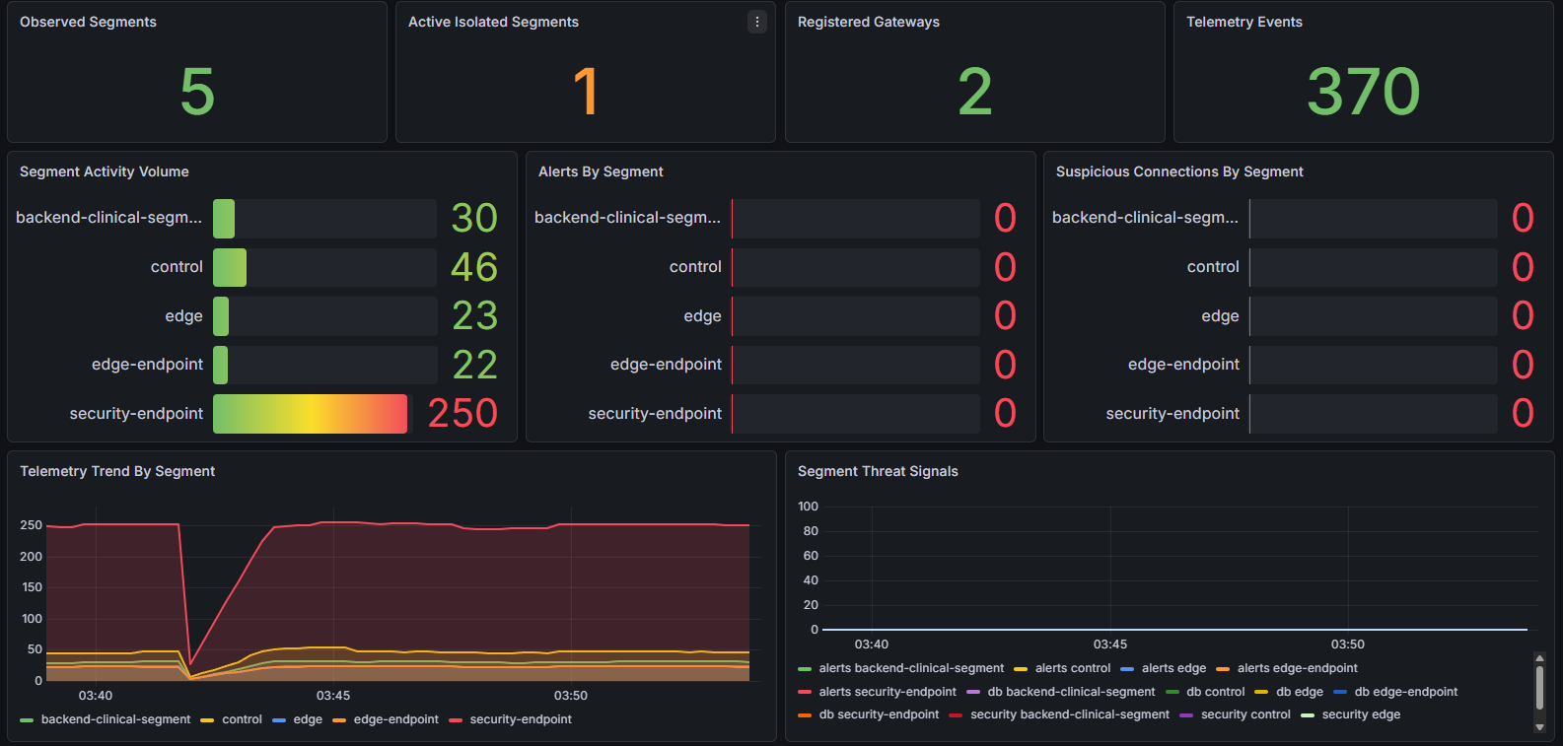
Results & Performance (2 of 2) — Response & Observability
Automated Response Actions by Alert Type
Alert Type | Severity | Response Action | IAM Action
ROLE_ACCESS_VIOLATION | HIGH | restrict | Token revocation
EXFILTRATION_DETECTED | CRITICAL | isolate | Revocation + IP block
RANSOMWARE_INDICATOR | CRITICAL | isolate | Revocation + IP block
BRUTE_FORCE_ATTEMPT | HIGH | restrict | Token revocation
ML_ANOMALY (low conf.) | LOW | log_only | None
Grafana Dashboard — Observed Runtime Metrics
13
Zero Trust Security Framework for Healthcare Systems
AMRITA VISHWA VIDYAPEETHAM

Slide 14
Evaluation & Analysis (1 of 2) — Meeting Objectives
EDR Deployment
EDR agents deployed on all critical endpoints; telemetry centralized from workstations, IAM, backend, encryption, and monitoring services.
✓ Met
Microsegmentation
SDP-based segmentation enforced; backend-clinical-segment dynamically isolated during incident; lateral movement prevented throughout test.
✓ Met
Real-time Monitoring
Grafana showed segment-level activity throughout that run. Metrics are runtime-dependent and vary by scenario duration and traffic.
✓ Met
Demo attack scenarios with live detection and response
It shows the detected attack type, alert severity, and response state during the demo run..
✓ Met
Automated Response
Severity-based enforcement confirmed: isolate for CRITICAL, restrict for HIGH, log_only for LOW. revert_isolation action validated successfully.
✓ Met
14
Zero Trust Security Framework for Healthcare Systems
AMRITA VISHWA VIDYAPEETHAM

Slide 15
Evaluation & Analysis (2 of 2) — SOTA Comparison & Strengths / Limitations
Comparison with Existing Approaches
Strengths & Limitations
Feature | Traditional | SecureHealthCare
Trust Model | Perimeter-based | Zero Trust (IAM → SDP → EDR → Response)
Access Control | Static Access Control Lists | Dynamic SDP + role policies
Threat Detection | Signature-only | Rule + ML (hybrid)
Response | Manual | Automated severity-based (token revoke, segment isolate)
Microsegmentation | None / static | Dynamic isolation via SDP
Audit Trail | Partial | Full — every action logged
Strengths
End-to-end Zero Trust prototype— every request verified, every action auditable.
Hybrid detection: rules + ML .
Dynamic reversible microsegmentation — no permanent lockouts.
Demonstrated attack scenarios with response – exfiltration , role violation, brute force as shown in the demo
Docker deployment — reproducible in controlled test environments.
Limitations
Tested in simulated Docker environment — not validated on a live hospital network.
Reversible isolation is audit driven , not automatic
No IoMT (embedded medical device) telemetry coverage in current deployment.
ML trained on IDS2018 — a healthcare-specific dataset would improve accuracy.
15
Zero Trust Security Framework for Healthcare Systems
AMRITA VISHWA VIDYAPEETHAM

Slide 16
Challenges & Solutions
⚠ Hybrid Threat Detection: Rules + ML
✓ Traffic analyzer (4 core rules: exfil, ransomware, brute force, role violation) runs in parallel with ML anomaly scoring -both routes feed into response controller for correlated escalation.
⚠ Distributed Alert Normalization & Real-Time Correlation
✓Centralized collector (monitoring/collector.js) ingests from traffic analyzer (rules), ML engine (anomaly), EDR agents (telemetry), backend middleware (role violations), and database monitor; response controller prioritizes by severity + ML confidence.
⚠ SDP Policy Enforcement Consistency
✓ Centralized policy configuration in SDP controller; role-path matrix evaluated at gateway before any backend forwarding — no bypass paths possible.
⚠ Attack Visualization and Classification
✓Dashboard maps live telemetry and alerts to attack categories, letting the demo show what type of attack was detected and what response was triggered.
⚠ Reversible Microsegmentation
✓ Response controller maintains isolation state with rollback tracking; revert_isolation action confirmed in validation — no permanent service lockout.
16
Zero Trust Security Framework for Healthcare Systems
AMRITA VISHWA VIDYAPEETHAM

Slide 17
Conclusion
SecureHealthCare demonstrates a validated Zero Trust prototype for healthcare in a containerized simulation environment, integrating identity-based access control, continuous endpoint telemetry, hybrid threat detection (rule + ML), and automated rule based containment.
Identity & Access Control (Phase I)
IAM with bcrypt + TOTP MFA, SDP policy enforcement, SPA admission — zero implicit trust at any layer of the stack.
Telemetry & Detection (Phase II)
EDR agents + centralized collector + rule engine + Random Forest ML — 95.27% attack recall, 0.9872 ROC-AUC on validation.
Automated Response
Severity-aware enforcement: isolate, revoke, restrict — fully logged, auditable, and reversible with revert_isolation confirmed.
Practical Foundation
Docker Compose deployment with 12 microservices demonstrates architectural feasibility and reproducible validation in a simulated environment; live hospital deployment requires additional operational, regulatory, and clinical validation.
17
Zero Trust Security Framework for Healthcare Systems
AMRITA VISHWA VIDYAPEETHAM

Slide 18
Future Scope
Dynamic Risk Assessment
Compliance Audit Logs
Automated Recovery
Continuously update risk scores for users and devices using existing telemetry streams (identity, role, endpoint behavior, and alert history), enabling adaptive trust decisions per session.
Structured audit reports aligned with HIPAA and other regulatory frameworks — forensic-ready evidence trail for investigations.
Workflows that restore isolated services and revoked tokens after threat containment is confirmed — reducing operational downtime.
IoMT Integration
ML Explainability (SHAP)
Live Healthcare Validation
Introduce lightweight telemetry adapters for selected IoMT/medical devices and map device events into the existing collector schema for broader perimeter visibility.
Add model explainability (for example, SHAP-based feature attribution) to provide human-readable reasons for ML alerts and improve clinical and audit interpretability.
Test framework in a real hospital network with actual EHR systems, proprietary medical devices, and live patient data workflows.
18
Zero Trust Security Framework for Healthcare Systems
AMRITA VISHWA VIDYAPEETHAM

Slide 19
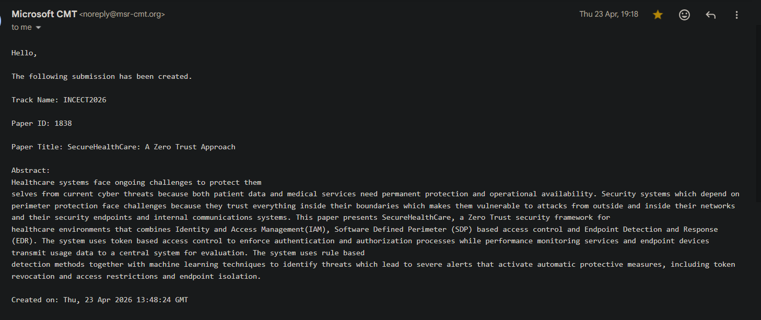
Publication Status
Paper Title:
SecureHealthCare: A Zero Trust Security Framework for Healthcare Systems
Conference:
INCECT
Publisher:
IEEE
Date of Conference:
21/08/26 – 22/08/26
Status:
Submitted
[ Add screenshot of acceptance / submission confirmation here ]
19
Zero Trust Security Framework for Healthcare Systems
AMRITA VISHWA VIDYAPEETHAM

Slide 20
Questions
DOUBTS & QUESTIONS ??
20
Zero Trust Security Framework for Healthcare Systems
AMRITA VISHWA VIDYAPEETHAM

Slide 21
THE END
THANK YOU!
21
Zero Trust Security Framework for Healthcare Systems
AMRITA VISHWA VIDYAPEETHAM

